Slide 1
A E S Loghapriya
Excel final Assessment

Slide 2

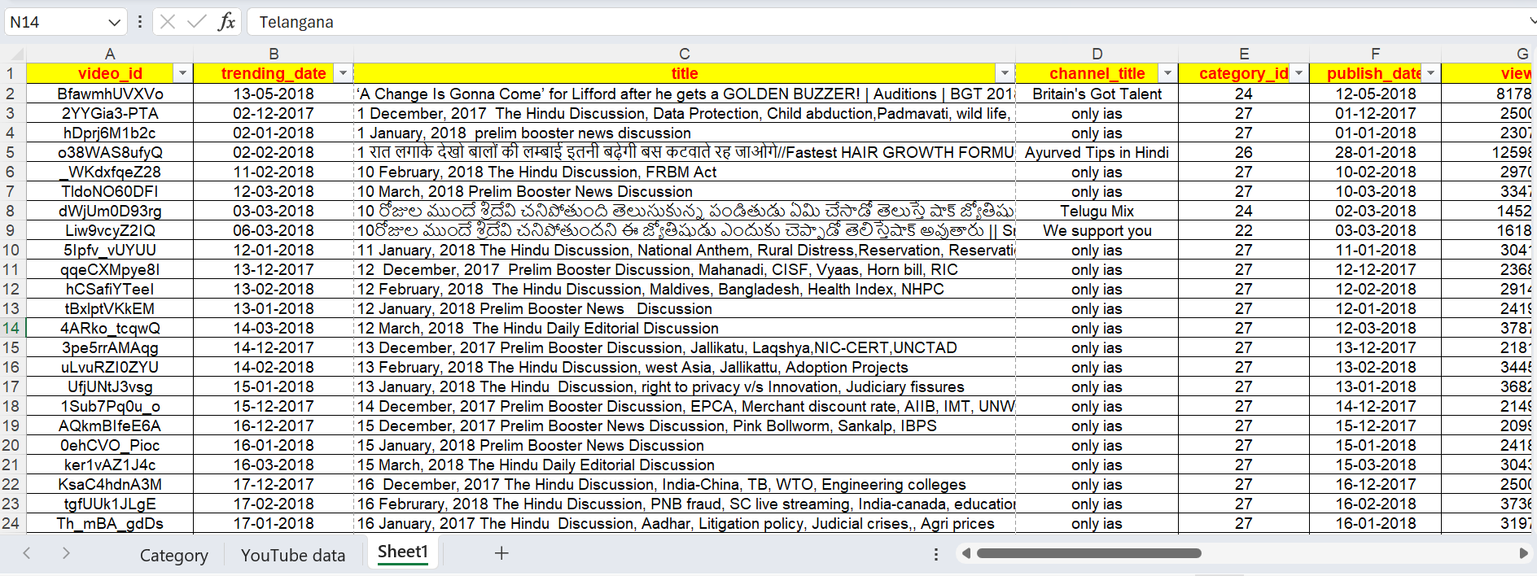
Question 1
To change the comments count to 1 as there is only one comment under each Video.

Slide 3
Question 2 – Time Analysis

Slide 4
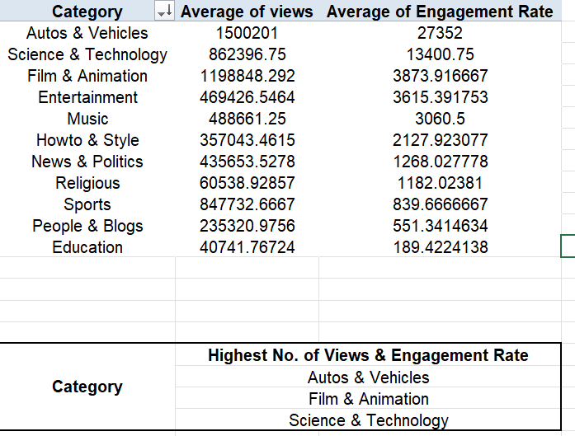
Question 3 – Category Analysis
STEPS:
Using Xlookup, create a Category column corresponding to each video with its category ID.
Then, Create a new column – Engagement rate with the formula : =SUM($H2,$J2).
Create a pivot table that contains the category, Avg of Views and Avg of Engagement rate.
Then sort the category w.r.t. Avg Views in Descending order.
INSIGHTS:
The Top 3 categories with highest average views and engagement rate are:
Autos & Vehicles
Film & Animation
Science & Technology

Slide 5
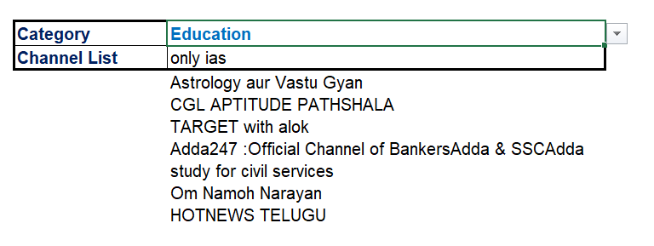
Question 4 – Filter and xlookup
=XLOOKUP($E2,Category!A:A,Category!B:B)
=UNIQUE(FILTER(dataQ4!D:D,dataQ4!Q:Q=Sheet6!D1))
Steps:
Create a new column category name, and using xlookup fill the name according to the category ID.
Using Filter, list out the channel list under the specified Category.
Insights:

Slide 6
Question 5
=CONCATENATE(C2:C593,D2:D593)
=TEXTJOIN("|",TRUE,P2,R2)
Steps:
Using concatenate formula, join the two columns, channel title & Title.
Then using textjoin with delimiter – “|”, Join the comments and title. (As there is no multiple comments for a single video, I have Joined title and comments)

Slide 7
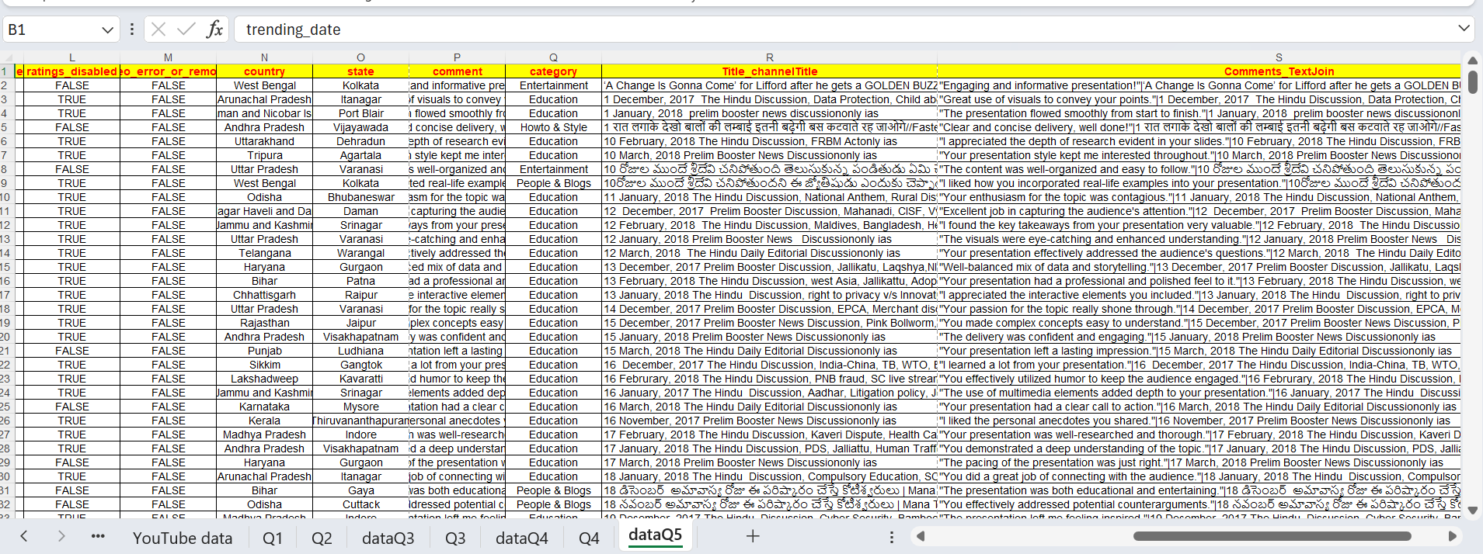
Question 5 - Snapshot

Slide 8
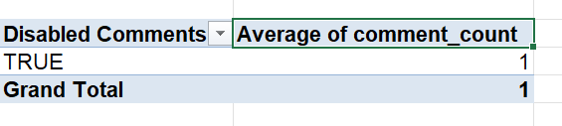
Question 6
Steps:
Create a pivot table selecting all rows, Then add Disable comments in rows and Average of comments_count in Values.
As the comments are disabled for all the videos, the avg of comments disable is 1.

Slide 9
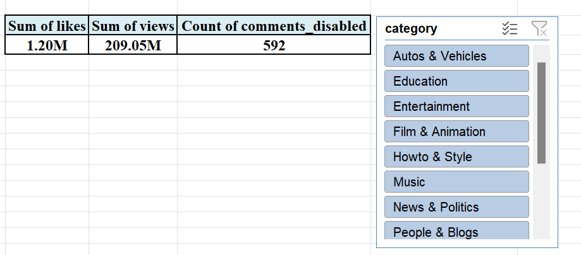
Question 7
Steps:
Create a pivot table with Sum of Likes, Sum of Views, And count of comments disabled.
Format the numbers into Millions using 0.00,,”M”
Then add the slicer to Pivot with Category.
Insights:
The highest number of Views is in Entertainment category - 91.07M .
The values differ a lot with each category.

Slide 10
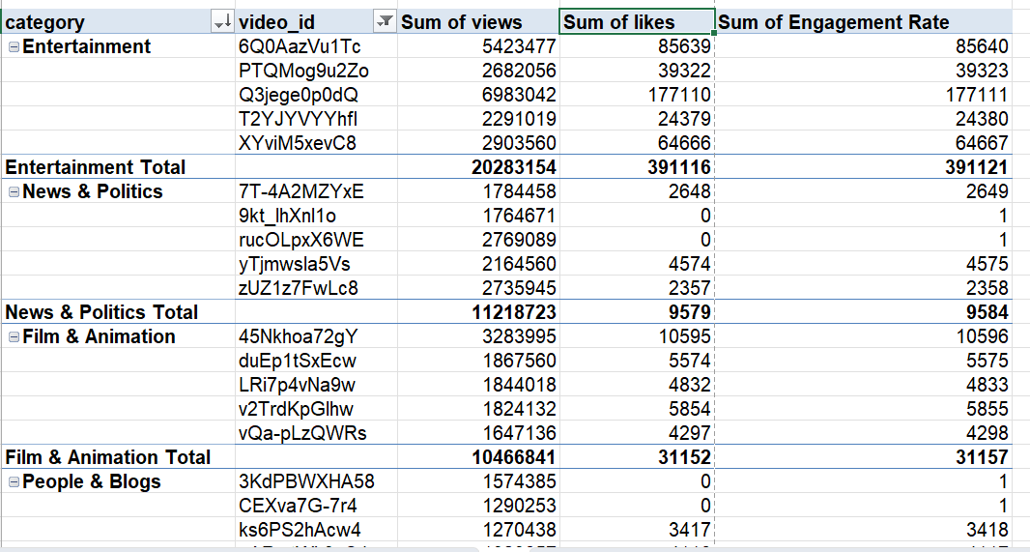
Question 8
Steps:
Create a pivot with category and video ID as rows. And Sum of views, likes and Engagement rate as values.
Then change it into tabular form and remove the grand totals.
Then Sort the table in descending order w.r.t sum of views and then select the Top 5 in each Category.

Slide 11
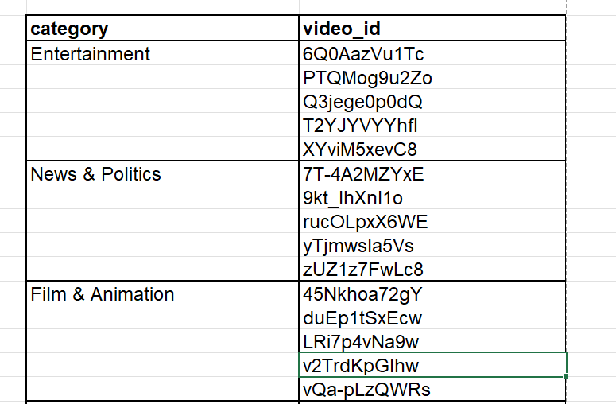
Top 5 videos in each category
category | video_id
Entertainment | 6Q0AazVu1Tc
 | PTQMog9u2Zo
 | Q3jege0p0dQ
 | T2YJYVYYhfI
 | XYviM5xevC8
News & Politics | 7T-4A2MZYxE
 | 9kt_lhXnl1o
 | rucOLpxX6WE
 | yTjmwsla5Vs
 | zUZ1z7FwLc8
Film & Animation | 45Nkhoa72gY
 | duEp1tSxEcw
 | LRi7p4vNa9w
 | v2TrdKpGlhw
 | vQa-pLzQWRs
People & Blogs | 3KdPBWXHA58
 | CEXva7G-7r4
 | ks6PS2hAcw4
 | pARwtWh3cC4
 | rWVgT8Rbk-c
Howto & Style | g4XLlizgeC0
 | G6a67bzgy2w
 | h6Z9mmSNJcw
 | o38WAS8ufyQ
 | Xpzc6hZpVKI
Science & Technology | GNloY_4s8RA
 | IprmiOa2zH8
 | ogfYd705cRs
 | xq_6mXK-5hI
Autos & Vehicles | gbRijjvIeyk
 | M63L7XozWbY
Sports | 476M0nR46bs
 | fNddOeXJj3Y
 | Hy8ISlyuz-A
Music | 9xWc6dYwkRA
 | p7tLPOnkzE8
 | QF9dcrBABdc
 | yS0QXeFz7Uc
Education | 59B8UR6l824
 | K_b4KfPFqSA
 | kyu8bTVhXMU
 | Rhq6uJkoy_o
 | SrmBuGll6No
Religious | 0eSiddTE0Oo
 | 2eiBztJHjBY
 | doqFLMEUVXc
 | WEW4DESwnF8
 | WSU5NcuYIb8

Slide 12
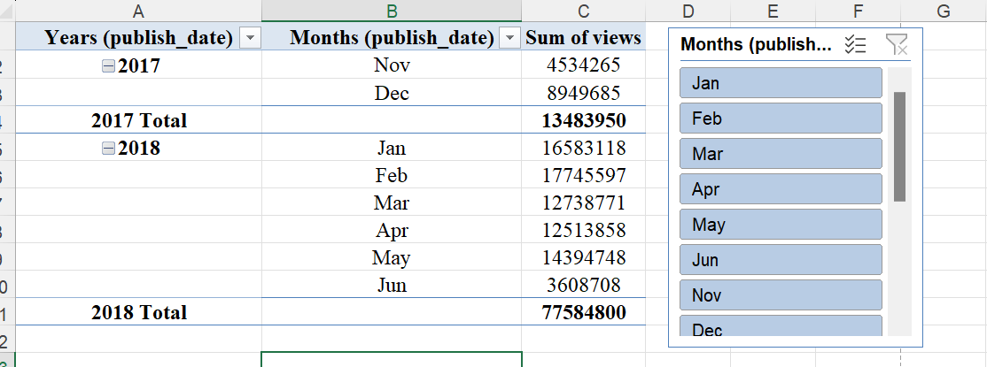
Question 1
Insights:
2018 has highest number of views.
In 2018, feb month has highest views and jun month has lowest views.
Steps:
To create a pivot table with Publish date in rows and Sum of views in columns.
Then group the publish date with Year and Month.

Slide 13
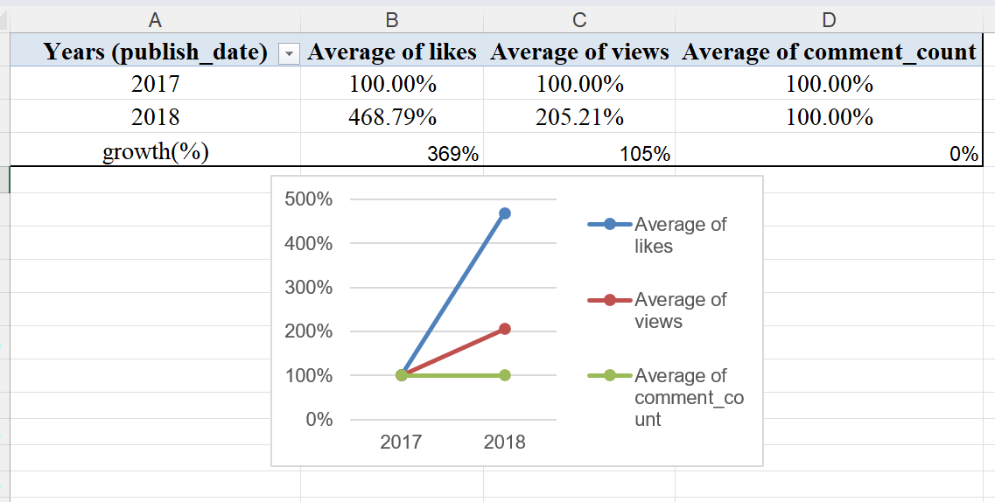
Question 10
Insights:
There is significant growth of about 369% in the year 2018 w.r.t. Average Likes.
In case of Average views, the is moderate growth of 205% in year 2018.
But there is no growth,it’s remains constant in the comments count over the years.
Steps:
Create a pivot table with year of publishing in rows and Avg of Likes, Views and Comments in values.
Then change the values to average and shows them as percentage with previous year data.
Create a line chart to show the growth in these columns.

Slide 14
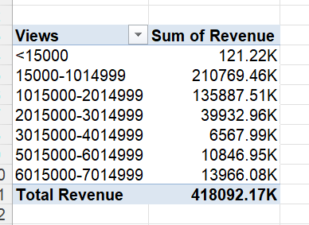
Question 11
Steps:
Create a pivot with Views and Revenue.
Calculate Revenue by Product of (views x 2) (Assume its 2rs for each view).
Now group the views
Insights:
The total revenue : 418092.17K
Highest revenue is earned for videos with 15000 – 1014999 views, followed by 1015000-2014999

Slide 15
Question 16

